Slide 1
CLEANED – Virtual Training 22nd /06/2020 – 03rd /07/2020
Jessica Mukiri, An Notenbaert, Emmanuel Mwema, Birthe Paul, Rein Van der Hoek
Cleaned@cgiar.org
CLEANED virtual training: 24/06/2020

Slide 2

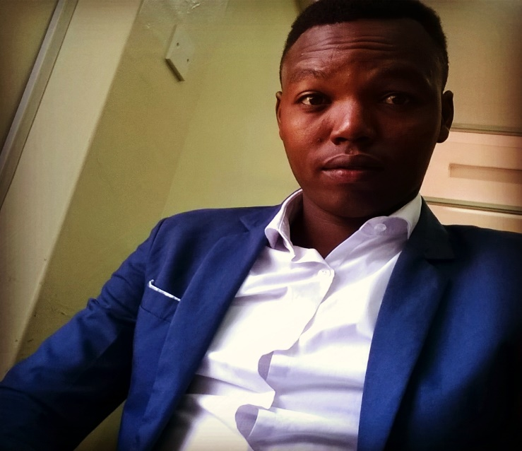

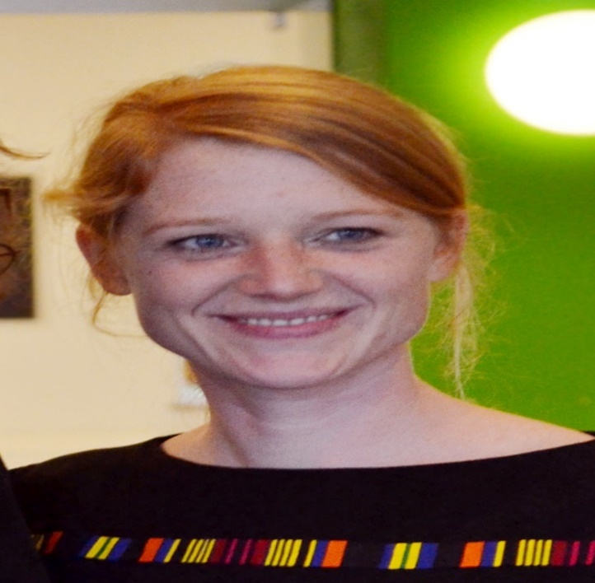

Name: Jessica Mukiri
Title: Environmental Modeler
Name: Emmanuel Mwema
Title: Environmentalist
Name: Rein Van der Hoek
Title: Forage Based Crop Livestock Systems Specialist
Name: Birthe Paul
Title: Farming Systems Scientist
Name: An Notenbaert
Title: Tropical Forages Lead Africa

Slide 3
LIST OF ALL PARTICIPANTS
Name | Country | Occupation
Hung Le Van | Vietnam | Scientist
Dao Thu Hang | Vietnam
Mai Tu | Vietnam | Livestock CRP
David Ngunga | Tanzania
Rukiko Patrick | Tanzania
Walter Mangesho Edward | Tanzania | Livestock researcher
Ngoteya Godfrey | Tanzania | Scientist/researcher
Wanyama Ibrahim | Uganda | Scientist
Kakungulu James | Uganda
kigozi Abas | Uganda | Scientist
Lukatome Pius | Uganda
Gloy Nele | Tunisia | Development practitioner/ adviser
Worku Bedeke | Ethiopia | Scientist/researcher
Tigabie Abiro | Ethiopia | program coordinator
Aemiro Kehaliew | Ethiopia | Scientist
Tarekegn Alemu | Ethiopia
Douxchamps Sabine
Mengistu Tesfaye Gatachew
Boniphace Dioniz
Rubayiza Isaac
Wahid Marouani
Jeremiah Adolf

Slide 4
TRAINING Expectations
Name | Expectations
Hung Le Van | To learn more about environmental impacts of animal production and how to use the CLEANED for calculating these impacts
Dao Thu Hang
Mai Tu
David Ngunga
Rukiko Patrick
Walter Mangesho Edward
Ngoteya Godfrey | To learn and be able to incorporate Climate Smart approaches/strategies in implementing Livestock/dairy initiatives.
Wanyama Ibrahim | To able to use the CLEANED to model impact of livestock production
Kakungulu James
kigozi Abas
Lukatome Pius | To be able to use the CLEANED assessment tool to design environmentally sustainable livestock systems in Uganda
Gloy Nele | To understand and be able to use the tool to calculate GHG/environmental impact of dairy livestock system in Tunisia (on project level first) to support the government to design a sustainable dairy value chain
Worku Bedeke | To understand how to analyze impacts of livestock production on environment through modeling
Tigabie Abiro | To understand the impacts of livestock production on environment, and how to manage those impacts and sustain the production improvement of livestock products.
Aemiro Kehaliew | To understand on how to model the impact of livestock production systems on the environment and thus able to measure and come up with possible mitigation options.
Tarekegn Alemu
Douxchamps Sabine
Mengistu Tesfaye Gatachew
Boniphace Dioniz
Rubayiza Isaac
Wahid Marouani
Jeremiah Adolf

Slide 5

Recap
Notes:
Show Agenda again

Slide 6
Present Assignment 1

Slide 7
Learning outcomes day 2
Identify the data needed and navigate the INPUT section in CLEANED for a livestock enterprise
Compare different data sources that can be used as input data for cleaned
Calculate the data needed for input for CLEANED

Slide 8
The livestock enterprise
8
Notes:
The CLEANED tool or the “Comprehensive Livestock Environmental Assessment for Improved Nutrition, a Secured Environment and Sustainable Development along Livestock and Fish Value Chains” tool is a rapid ex - ante environmental impact assessment tool.
The CLEANED tool lets users explore multiple impacts of developing livestock value chains in explicit ways. It models the impact of intensifying livestock along multiple pathways;
greenhouse gas emissions, biodiversity loss, soil health and economic impact.
The CLEANED tool was developed to be used in ongoing innovation processes in value chains to support decisionmakers understanding of the environmental impacts of growth and develop more inclusive and sustainable livestock intensification plans that mitigate the negative impacts and enhance the positive ones.

Slide 9
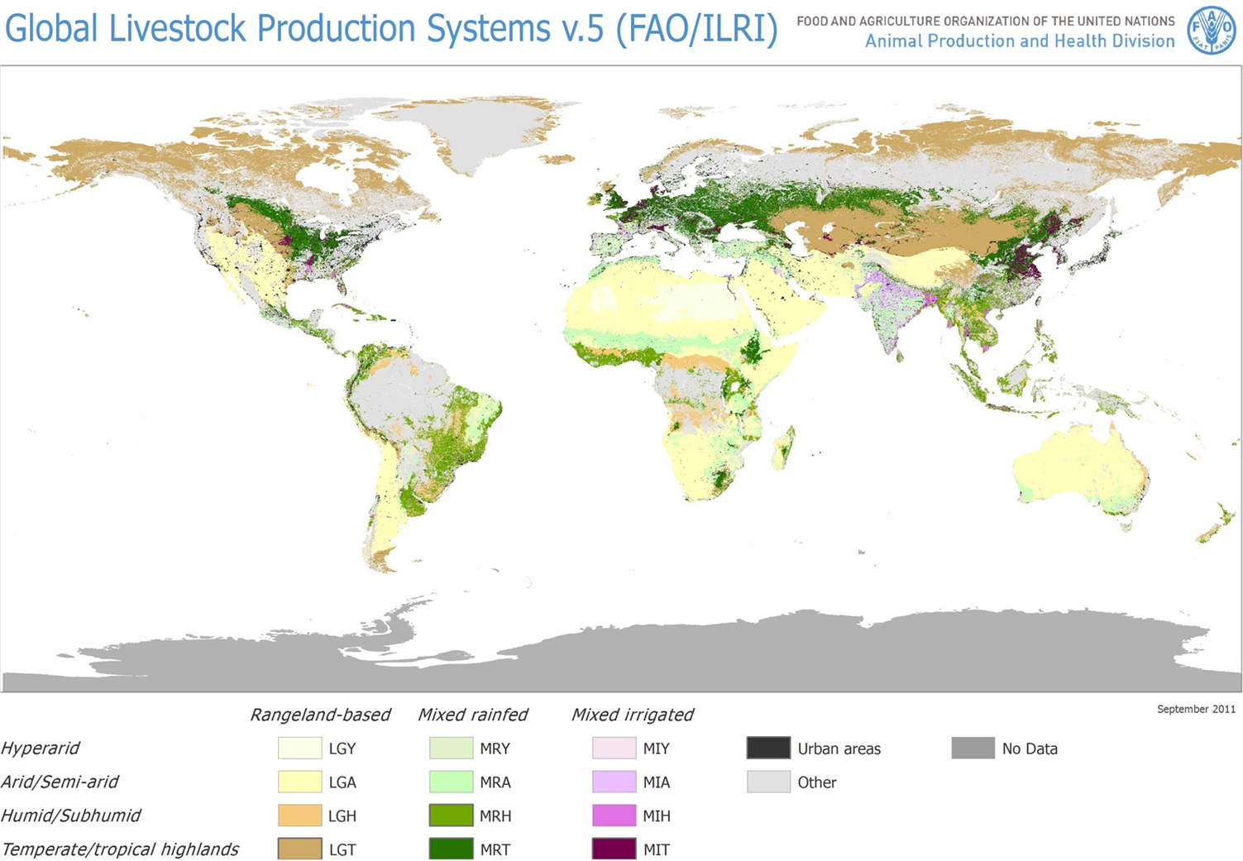
Livestock Systems/Enterprise/Farm

Slide 10
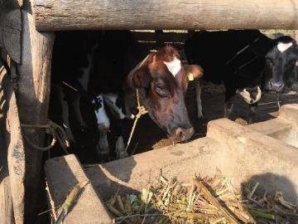
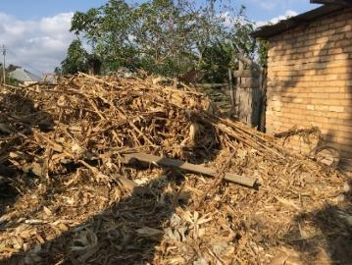
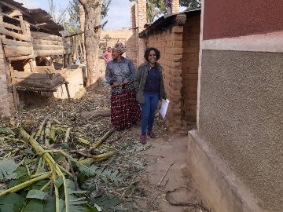
Smallholder dairy farm Tanzania
Maize 2017 | Maize harvest (kg/farm) | 740
Cows | 5 crossbreeds | 2 cows,3 heifers
Milk | Amount of milk in 2017 (liter or kg) | 1,540
Notes:
Discuss the livestock diet, Crop residues, Natural grasses, improved grasses, concentrates

Slide 11
The case study farm
Link
https://earth.google.com/earth/rpc/cc/drive?state=%7B%22ids%22%3A%5B%221cLqae0atsqiwlWkqj9FL25s09nqAwtlI%22%5D%2C%22action%22%3A%22open%22%2C%22userId%22%3A%22108792402099743746675%22%7D&usp=sharing

Slide 12
Breakout session 1
https://docs.google.com/presentation/d/1NOpqPgTGYN0MdNtZD_aZ101VEYRNqq4UIIRtqA13reQ/edit?usp=sharing

Slide 13
Hands on with the tool

Slide 14

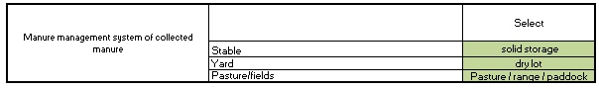




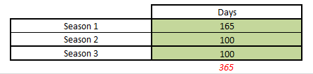
Inputs data input
conversation
Descriptors
expert opinion or observation
Input
statistics or surveys
Notes:
This is the overview of the tool, the white cells are descriptors and are fixed, the green cells are for inputting data. This might be quantities, dates, types or a selection from a drop down list.

Slide 15







Inputs overview
Agroecology
INPUTS section one
Land, Soil & Climate
seasons
Numerical data
Livestock
INPUTS section two
0.2
1500
30%
Numbers, Manure
& Waste
Dropdown options
Feeding
INPUTS section three
Feed basket
Production
INPUTS section four
Crop residue, inputs
and rice
Economics
INPUTS section five
Labor hours, costs for establishment and operations
Notes:
Add economics

Slide 16
Agroecology

Slide 17

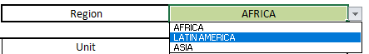
Inputs section one
Agroecology
Region: Select the region you are in from the drop down
Season 1: How many days in the year the first season lasts e.g. if Season 1 is the wet season and lasts 6 months that is roughly 180 days
Season 2: How many days in the year the first season lasts e.g. if Season 2 is the dry and lasts 4 months that is roughly 120 days
Season 3: this is optional, if you the system has three seasons follow steps above
Land, Soil & Climate
seasons
The model works on an annual basis make sure the days add up to 365

Slide 18
Livestock

Slide 19
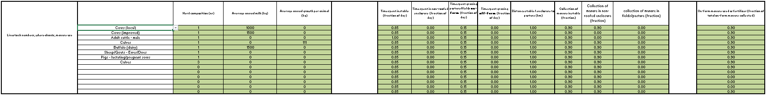
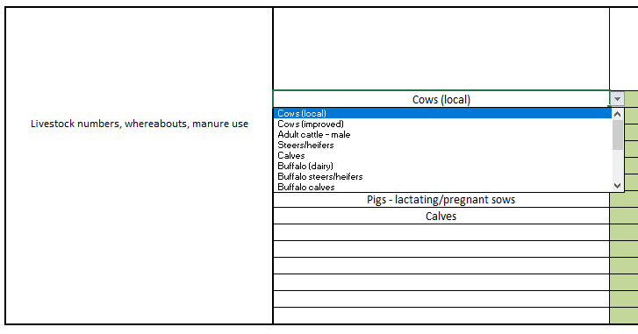
Inputs section two
Livestock
Numbers, Manure
& Waste

Slide 20
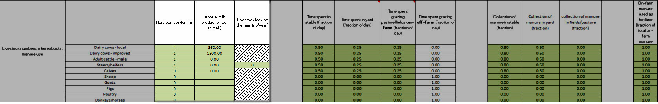
Inputs section two
Livestock
Herd composition: the number of animals in this category
Annual milk production: the total annual milk production (taking into account variances due to lactation period, etc). This information is only provided for the relevant livestock types (e.g. not for the poultry or the male cattle)
Numbers, Manure
& Waste

Slide 21
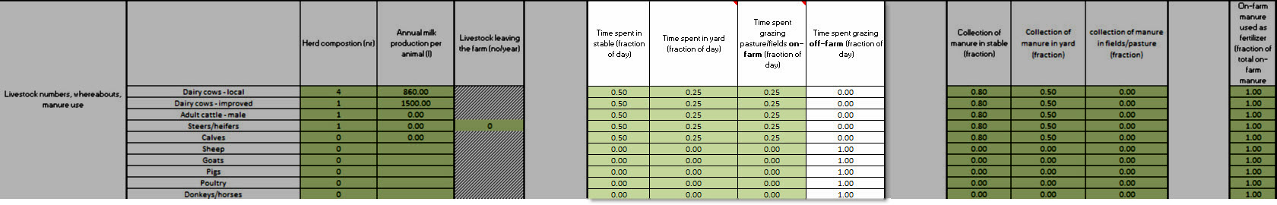
Inputs section two
Time spent in the stable: the fraction of the day that an animal of this type normally spends inside a stable; a stable is any structure where there is some form of closed space, and where the manure that is produced by the livestock remains away from the outside natural elements until it is collected and displaced.
Time spent in yard: a yard is therein defined as an enclosure or tethering area where the manure produced in that area is subject to the elements
Time spent grazing pasture/field on-farm
Time spent grazing off-farm: the value in this column calculated on the values you have input in the previous three columns. It is assumed that all time not spent in the stable, the yard or grazing on-farm, is spent grazing off-farm
Livestock
Numbers, Manure
& Waste

Slide 22
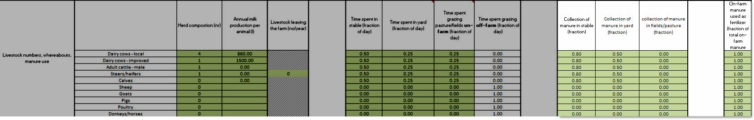
Inputs section two
Livestock
Collection of manure in stable: which fraction of the manure that is produced in the stable is collected vs. left on the floor
Collection of manure in yard: which fraction of the manure produced in the yard is collected vs. left on the soil
Collection of manure in fields/pasture: which fraction of the manure produced in the field or on the pasture is collected vs. left on the soil
On-farm manure used as fertilizer: in many farms, the manure is not only collected and stored but also used for fertilizing crops. Here you are asked to indicate which fraction of the collected manure is used as fertilizer.
Numbers, Manure
& Waste

Slide 23
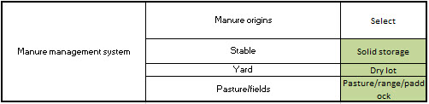
Inputs section two
Livestock
solid storage: The storage of manure, typically for a period of several months, in unconfined piles or stacks. Manure is able to be stacked due to the presence of a sufficient amount of bedding material or loss of moisture by evaporation.
dry lot: A paved or unpaved open confinement area without any significant vegetative cover where accumulating manure may be removed periodically.
pasture/range/paddock: The manure from pasture and range grazing animals is allowed to lie as deposited, and is not managed.
Numbers, Manure
& Waste

Slide 24
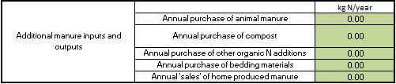
Inputs section two
Livestock
annual purchase of animal manure: if manure is bought, indicate here how much. This is expressed in kg N/year. E.g.
annual purchase of compost: if compost is bought, indicate here how much
annual purchase of other organic N additions: if any other organic sources of N are bought, indicate here how much
annual purchase of bedding materials
annual “sales” of home-produced manure:
Numbers, Manure
& Waste

Slide 25
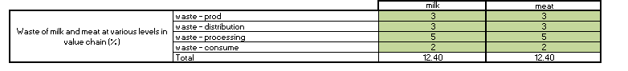
Inputs section two
Livestock
waste – milk and meat production
waste – milk and meat distribution
waste – milk and meat processing
waste – milk and meat consumption
Total: the total loss is calculated based on your input in the four waste cells above
default values in the model based on literature
Numbers, Manure
& Waste

Slide 26
Breakout session 2
Polly

Slide 27
Feeding

Slide 28
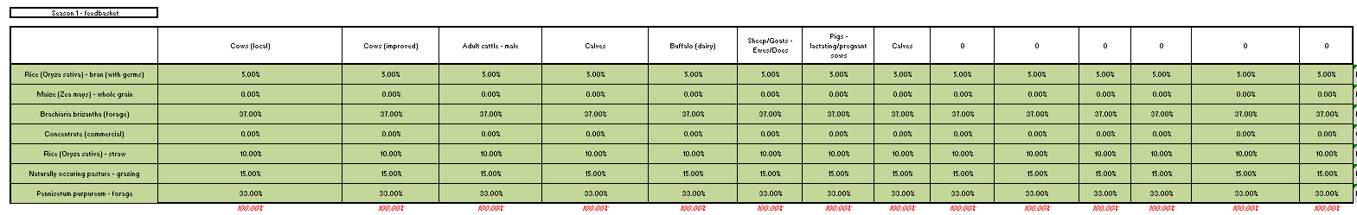
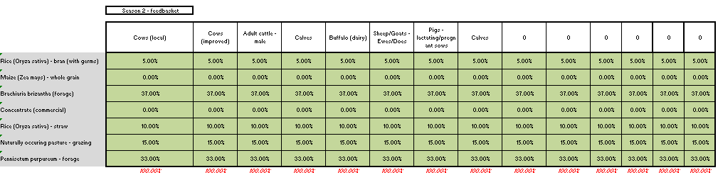
Inputs section three
Feeding
Feed basket

Slide 29
Inputs section three
Feeding
You start by selecting up to 7 different feed items. You simply pick the relevant ones from the drop-down lists that are found in the local dairy cow row (row 62). In the cell under the selected feed item, you indicate the % of the total feed basket that is made up by this feed item. This % is in terms of dry matter.
Make sure the %s add up to 100%
Feed basket
Notes:
Add that first row dictates all other rows

Slide 30
Inputs section three
Feeding
You start by selecting up to 7 different feed items. You simply pick the relevant ones from the drop-down lists that are found in the local dairy cow row (row 62). In the cell under the selected feed item, you indicate the % of the total feed basket that is made up by this feed item.
This % refers to the % “as fed”. Make sure the %s add up to 100%
Feed basket

Slide 31
Feed Production

Slide 32
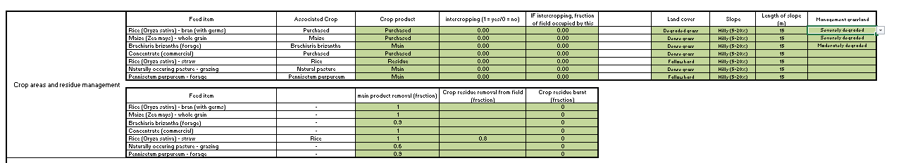
Inputs section four
Production
Crop residue, inputs
and rice

Slide 33
Inputs section four
Production
Land cover: the crop will determine the land cover. i.e. for beans the cover crop is “pulses”. In most cases, the user will select among “maize, cereals, pulses, dense or degraded grass”. In the case of tuber crops, it is suggested to select either “cereals “ or “pulses”.
Slope: this in an estimation of the degree of the slope from flat to extremely steep. The steeper the more erosion there will be.
Length of slope: This a drop down select what is relevant in your area
Management grassland: This a drop down select what is relevant in your area
Crop residue, inputs
and rice

Slide 34
Inputs section four
Production
Crop residue, inputs
and rice
Residue removal from field: the fraction of the totally produced crop residues that is removed from the field for feeding animals or for other purposes.
Residue burnt: the fraction of the totally produced crop residues that is burnt

Slide 35
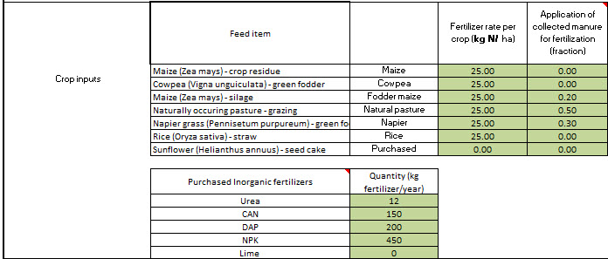
Inputs section four
For each crop associated with feed items:
Fertilizer rate: this is expressed in kg N/ha and thus requires conversions
This information is used for calculating nutrient balances and N2O emissions from each field
The purchased inorganic fertilizers:
Per type (Urea, CAN, DAP, NPK and Lime) state the total amounts of the different fertilizers per farm and year (not per ha, not per crop).
Production
Crop residue, inputs
and rice

Slide 36
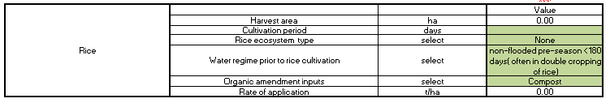
Inputs section four
This section only has to be filled out if there is Rice in the feed basket
Harvest area: calculated from the information provided above
Cultivation period: number of days the rice cultivation takes
Rice ecosystem type: select from the drop-down list
Water regime prior to rice cultivation: select from the drop-down list
Organic amendment inputs: select from the drop-down list
Rate of application: filled out based on information provided above
Production
Crop residue, inputs
and rice

Slide 37
Quiz 2
Link to Quiz 2
https://forms.office.com/Pages/ResponsePage.aspx?id=AA76ahT6t0CKLiKn-MNX1aE1vfzSBf5GkjzzKvqgj8ZUMDJNTk0xQU9JRDlDRTJNM1lGREMxWDVSWS4u

Slide 38
Assignment 2
Link to assignment 2:
https://form.jotform.com/201691661229052

Slide 39
Pre-recorded material
To access the CLEANED workbook please see
link: https://cleanedtraining.netlify.app/
To go directly to day 2: https://cleanedtraining.netlify.app/hands-on-with-the-input-section.html

Slide 40
Recap on what to do?
Quiz 2 :
https://forms.office.com/Pages/ResponsePage.aspx?id=AA76ahT6t0CKLiKn-MNX1aE1vfzSBf5GkjzzKvqgj8ZUMDJNTk0xQU9JRDlDRTJNM1lGREMxWDVSWS4u
Assignement 2 :
https://form.jotform.com/201691661229052
Deadline for Assignment 2 is tomorrow 13:00hrs GMT.
You access Rein, Emmanuel and Jess using this email Cleaned@cgiar.org between 15:00Hrs - 17:00Hrs today and between 08:00hrs and 11:00Hrs tomorrow.
Looking forward to seeing you all again on Friday morning.

Slide 41
Thank you!

